Slide 1
HotBox
CDR Presentation
Group 14

Slide 2
Chaitanya Vemuri
Major: Computer Engineering
Role: Backend/Embedded
Austin Tillotson
Major: Computer Engineering
Role: Frontend/Embedded
Haafiz Shafau
Major: Computer Engineering
Role: Hardware
Ahmed Kazzoun
Major: Computer Engineering
Role: Hardware/Embedded

Slide 3
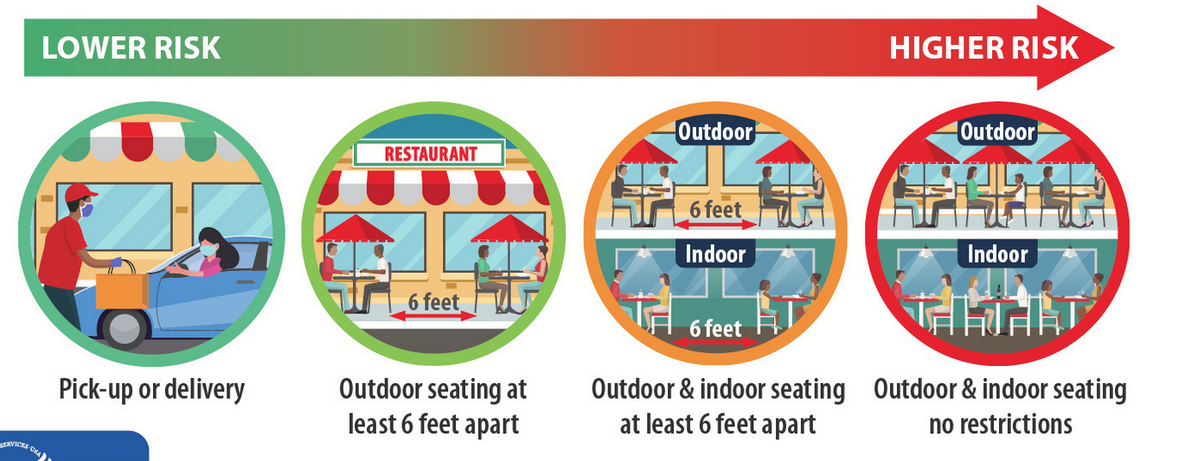
Motivation
Warm meals at your convenience
In 2020, over 60% of americans ordered takeout/delivery at least once a week. And with the COVID-19 pandemic, online ordering became high in demand.
Services such as DoorDash, UberEats, Online ordering and In-Store pickup became almost necessary to restaurants/stores. Thus still keeping traffic at these stores high.
A lot of the time, the food is prepared and left outside and becomes cold waiting for the customer/driver to pick up the food.
Haafiz

Slide 4
The Process
The HotBox houses foods stored in different materials, and keeps the contents warm and secure in a insulated locked electrical heating box.
The Hotbox sends out a notification to the customer, alerting them when their food is ready for pick up.
The HotBox scans in customer codes for order validation to increase the security of the box.
Haafiz

Slide 5
Goals and Objectives
Effectively keep product warm
Notifications
Safe to use
User friendly
Responsive
Database Storage
Secure
Haafiz

Slide 6
Hardware Specifications and Requirements
Accommodatable size
Set temperature and vary temperature as needed
Support different materials in heated temperatures
Box needs to have good security
Barcode scanner to unlock the box
Ahmed

Slide 7
Software Specifications and Requirements
MCU communication with web app
LCD displays order number to notify pickup
Web app must know the status of the boxes
Software must be able to control the temperature of the boxes
Barcode is used to give order details to box and web app
Database containing current and past orders
Software must be able to generate barcodes once an order is given to a box.
Austin

Slide 8
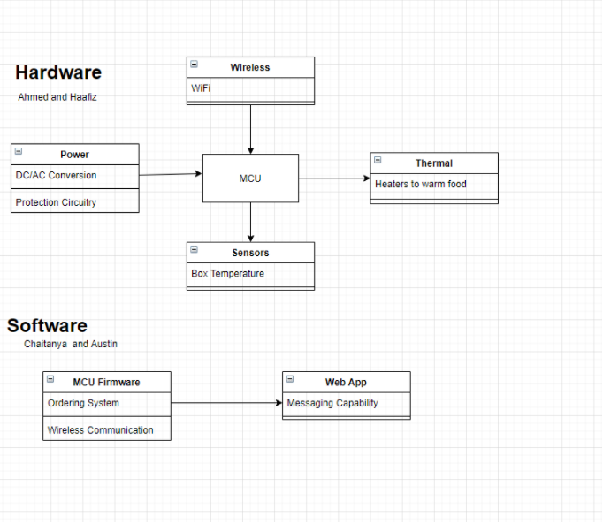
Block Diagram
Ahmed

Slide 9
Hardware Design

Slide 10
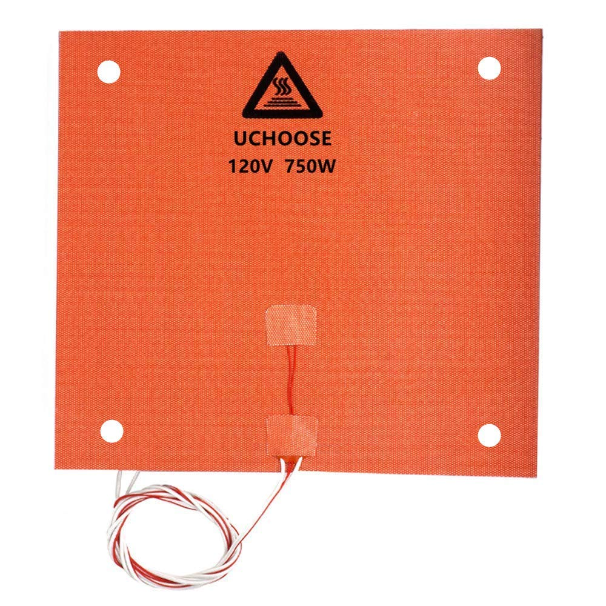
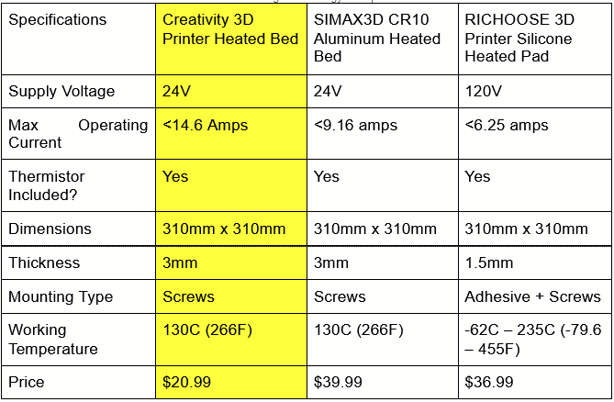
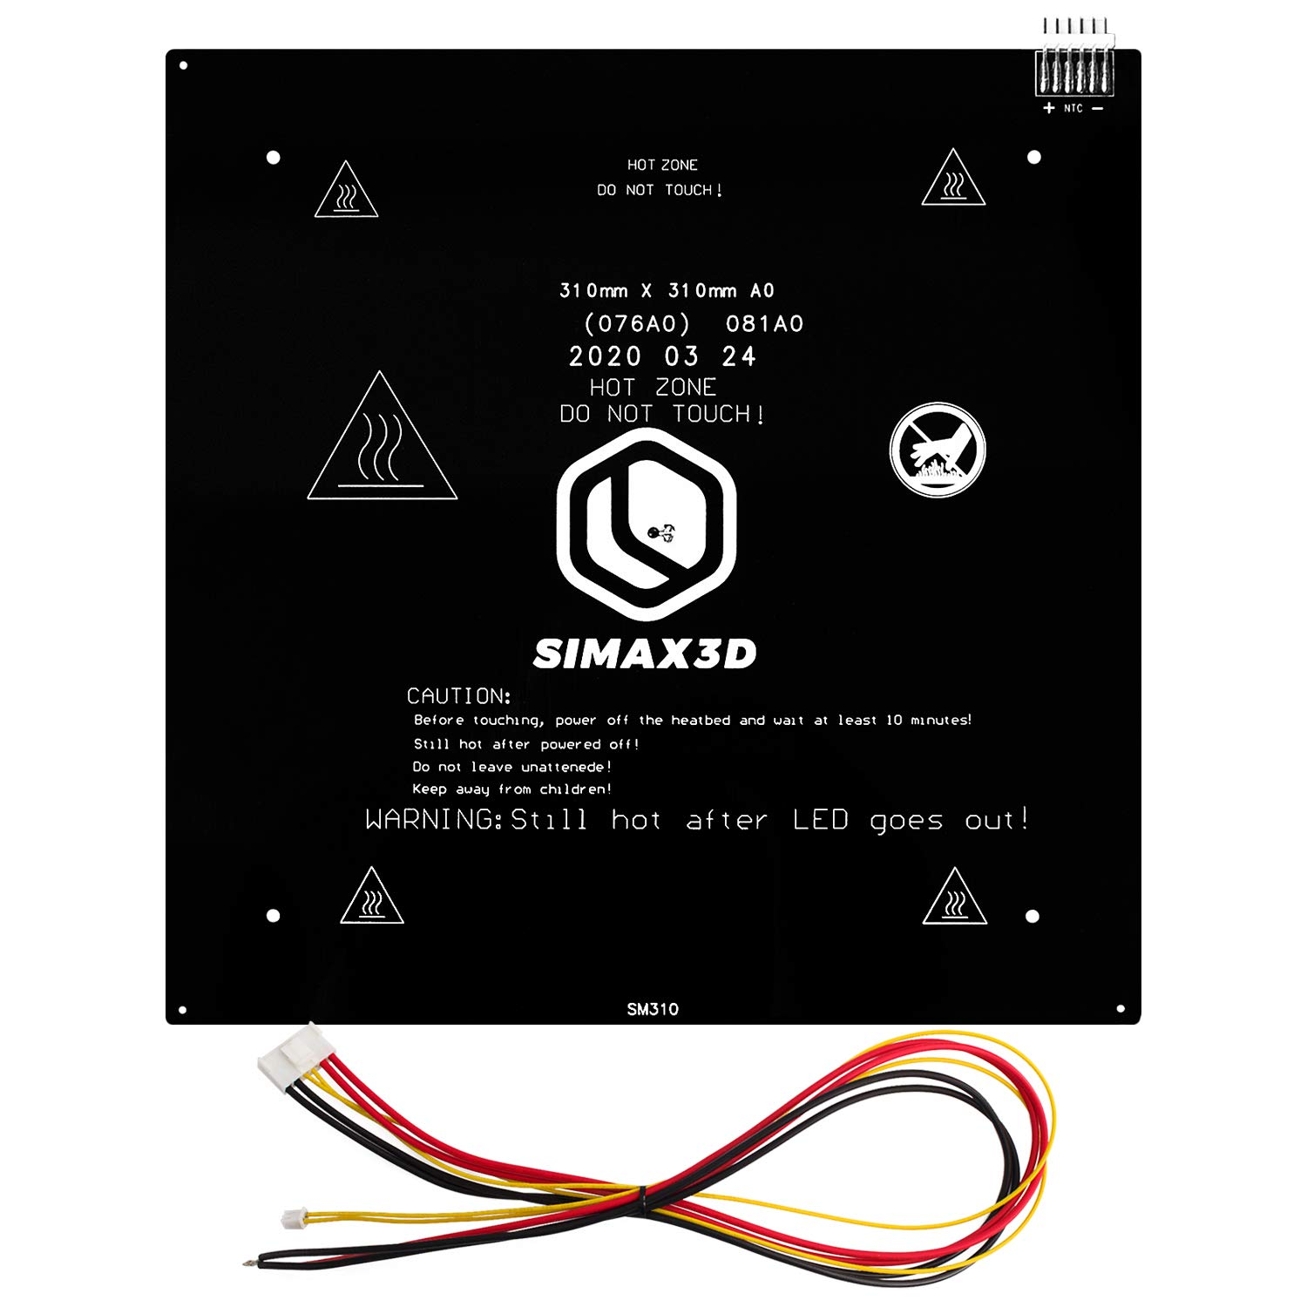
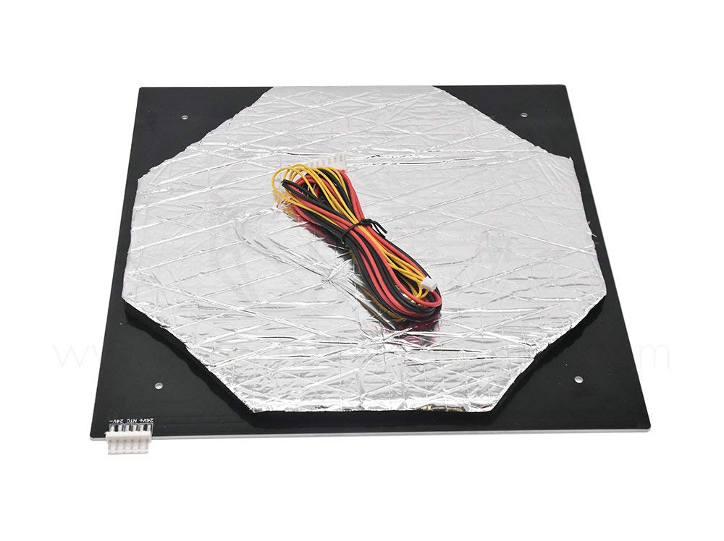
Heating Plate
Heating plate selection
RICHOOSE 3D Heated Pad
SIMAX3D Heated Bed
Creativity 3D Heated Bed
Haafiz

Slide 11
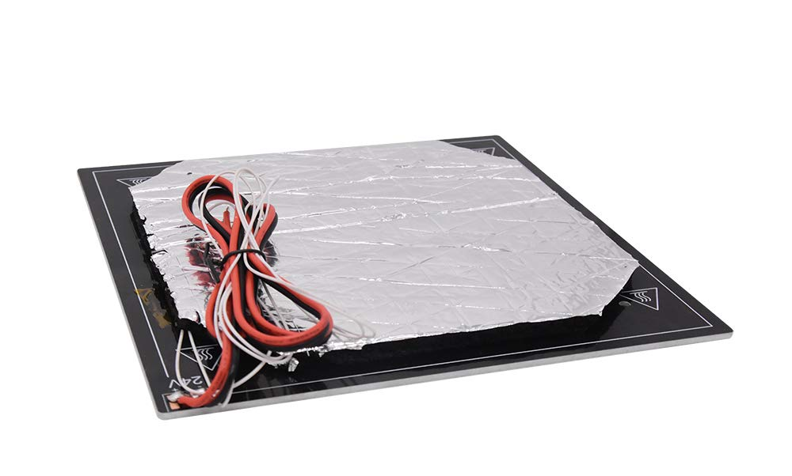
Heating Plate
Creativity 3D Heated Bed
Specifications
Supply Voltage | 24V
Operating Current | <14.6Amps
Manufacturer | Creativity
Dimensions (LxW) | 310mm x 310mm
Thickness | 3mm
Maximum Temperature | 130C (266F)
Haafiz

Slide 12
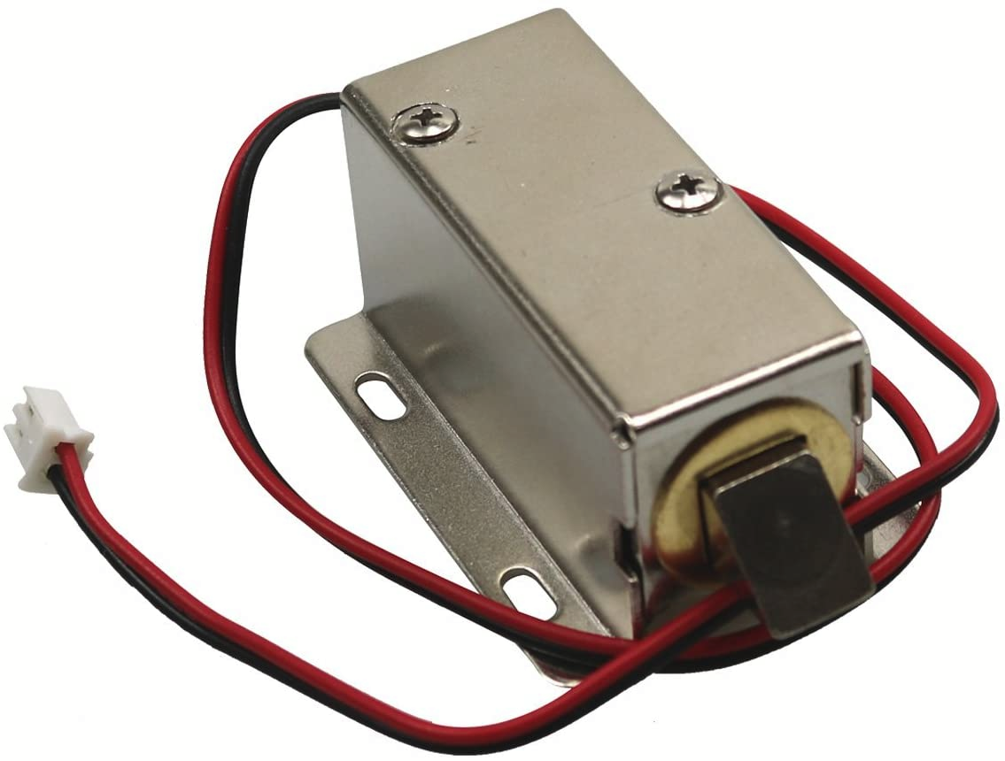
Solenoid Lock
MXBB DC 12V 0.8A 10mm Stroke Electronic Cabinet Lock
Specifications
Supply Voltage DC | 12V
Operating Current | .8A
Manufacturer | MXBB
Dimensions (LxWxH) | 2.13 x 1.54 x 1.1 inches
Material: | Metal
Weight | 155 grams
Unlocking time | ≤1S
Haafiz

Slide 13
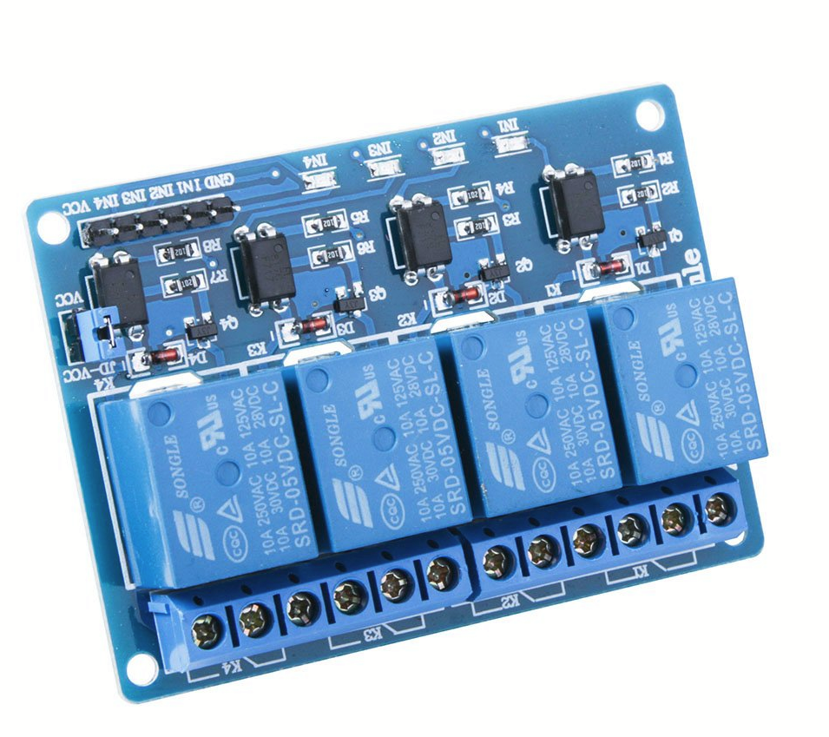
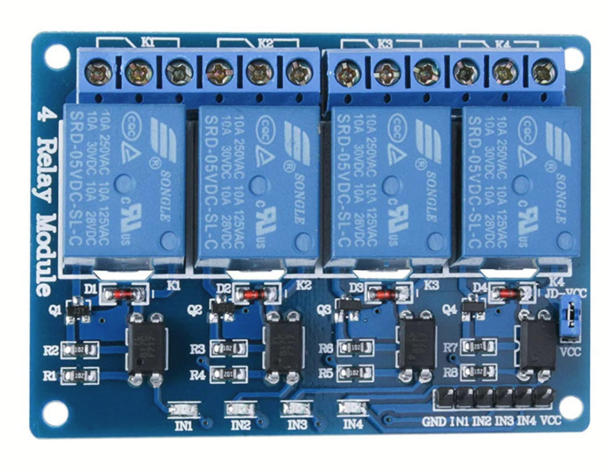
5V Relay
5V active low relay module equipped with 4 channels
Standard interface can be directly connected to a wide variety of microcontrollers (including Arduino)
Will be used to control devices that operate at higher voltages i.e Heating Pad, Solenoid Lock
Specifications
Power Supply DC | 5V
Load Voltage | AC 250V, DC 30V
Load Current | 10A
Manufacturer | ELEGOO
Dimensions (LxWxH) | 2.76 x 2.36 x 0.7 inches
Weight | 122 grams
Haafiz

Slide 14
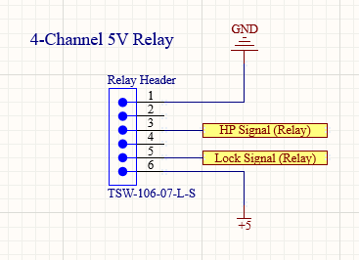
5V Relay Schematic
Pin | Label | Type | Description
1 | GND | GROUND | Power Ground
2 | IN1 | Input | Input Signal 1
3 | IN2 | Input | Input Signal 2
4 | IN3 | Input | Input Signal 3
5 | IN4 | Input | Input Signal 4
6 | VCC | POWER | 5V Power Supply
HP Signal - Heating Pad Signal
Lock Signal - Solenoid Lock Signal
Haafiz

Slide 15
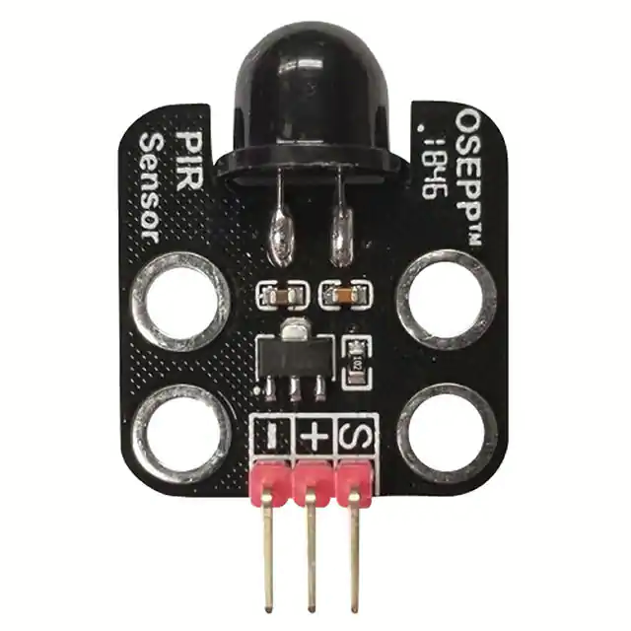
Infrared Sensor
OSEPP PIR-02
Passive Infrared Sensor - PIR-02
100% Arduino Compatible
Operating Voltage 5-12V
Digital Input Sensor
Detects variations in motion
Haafiz

Slide 16
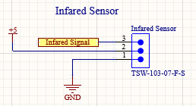
Infrared Sensor Schematic
Pin | Label | Type | Description
1 | (GND) | GROUND | Power Ground
2 | (VCC) | POWER | 5V Power Supply
3 | S | Output | Signal Line
Haafiz

Slide 17
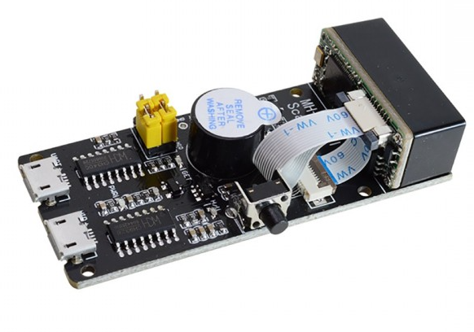
Barcode Scanner
MH-ET LIVE Barcode Scanner V3.0
Dimensions (LxWxH): 65x28x13.7mm
Micro USB UART interface
Micro USB HID (Human Interface Device/keyboard) interface
Can scan in both 1D format and 2D format
2D format: QR Code, PDF417, Data Matrix
Ahmed

Slide 18
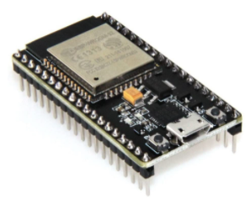
Wi-Fi Module
ESP32-DEVKITC-32D
2.4 GHz WiFi and Bluetooth module that integrates the TSMC ultra-low power technology.
IEEE 802.11 standard security features all supported, including WFA, WPA/WPA2 and WAPI
Made with the official WROOM32 module
That module contains a dual-core ESP32 chip, 4 MB of SPI Flash, tuned antenna.
Built-in USB-to-Serial converter, automatic bootloader reset, Lithium Ion/Polymer charger.
Ahmed

Slide 19
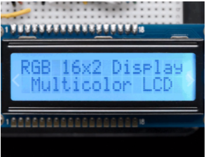
LCD Display
Adafruit RGB backlight positive LCD 16x2
Specifications
Supply Voltage DC | 3V or 5V
Manufacturer | Adafruit
Dimensions (LxWxH) | 27mm x 71mm / 1.1in x 2.8 in
Display Length | 16 characters wide, 2 rows
Languages | English/Japanese text
Ahmed

Slide 20
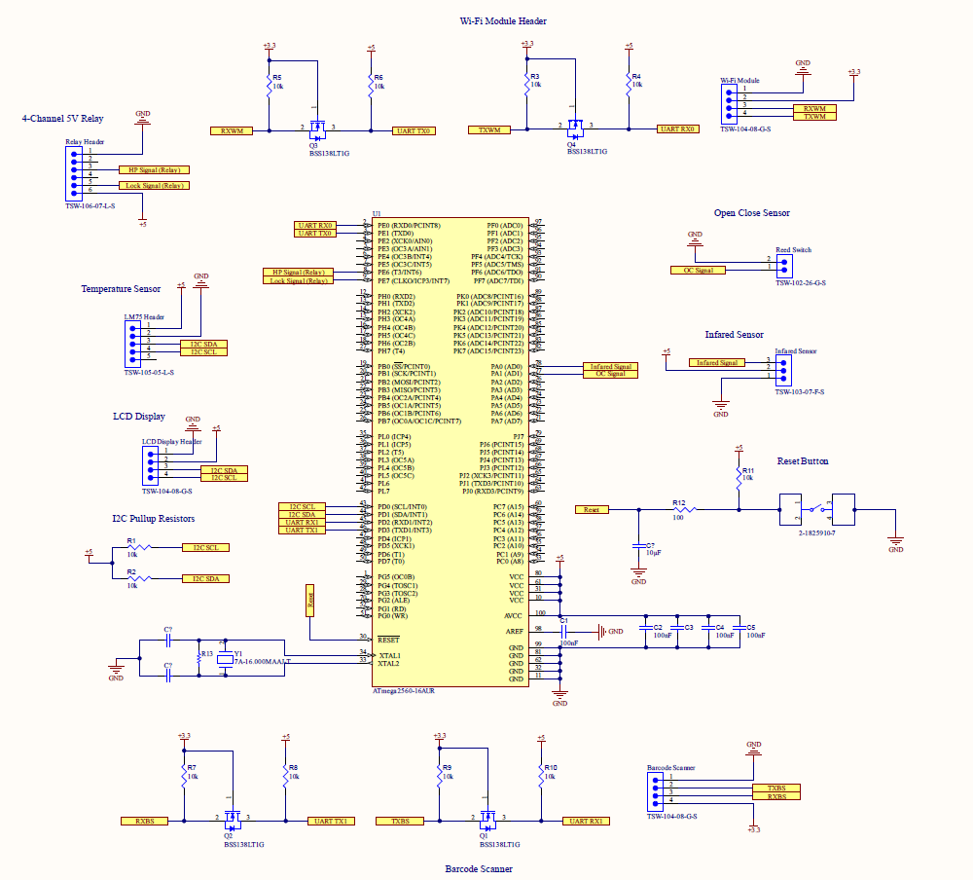
Overall PCB Schematic
Designed on Altium Designer
Haafiz

Slide 21
Box Design
Top
Top
Middle
Middle
Bottom
Bottom
Front View (interior)
Side View (interior)
Wooden Exterior
Haafiz

Slide 22
Software Design

Slide 23
Software
Embedded Software is used for the functionality of the HotBox
Allow control over how the HotBox will function depending on the request
Demo Site used to send requests to the HotBox
Ability to produce Barcode based on specific request
Communicate which HotBox contains what specific order
Communicates intent of HotBox to MCU
Austin

Slide 24
Technologies Used
Austin

Slide 25
Software Stack
MERN Stack
Database | MongoDB
Backend Framework | ExpressJS
Frontend Framework | ReactJS
Runtime Environment | NodeJS
Chaitanya

Slide 26
Platform Programming Languages
Embedded
Using Arduino IDE, we wrote the embedded implementation primarily in C for the barcode scanner, temperature module, and the box switch.
Framework
Javascript was the primary language used, along with various npm packages for addons. ExpressJS, ReactJS, and NodeJS were used to write the frontend and backend framework.
Database
MongoDB uses MQL, which is a unique querying language, connected to the backend framework with the npm package mongoose.
Chaitanya

Slide 27
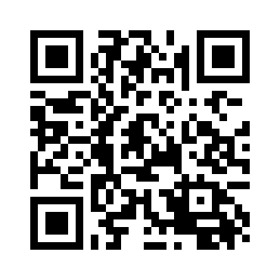
Barcode Scanner
Create barcode containing order information
Scan code to get order information
Scanned by the box
MCU sends order information to web app
Web app retrieves order info, sends out requests
HotBox’s GitHub
Chaitanya

Slide 28
Barcode Scanner Flowchart
Scan Barcode
Unlock box
Send data to MCU
Send request to MCU to unlock box
Decipher and send to WiFi module
Give customer box number
Yes
Did the WiFi module receive relay?
Did web application receive relay?
Yes
Send data to web application
No
No
Display Error
Close connection
Error

Slide 29
Magnetic Reed Switch
Constantly checks if HotBox door is open or closed
Returns status of door when called
Used by other embedded software
Austin

Slide 30
Magnetic Reed Switch Flowchart
Loop
Check Voltage Level
Is the level HIGH or LOW?
Door is closed
Door is open
LOW
HIGH
Return that door is closed
Return that door is opened
Error

Slide 31
Temperature Modulation
Embedded software adjusting temperature of heating pad
Temperature set/controlled by Web App
Temperature is set based on heat needed for specific order
Web app sends request to MCU
MCU sends request to modulator to change temperature
Austin

Slide 32
Demo Web Application
Web Application used to process orders
Communicates requests from user to HotBox
Displays status of all boxes in system
Contains order information for each box for viewing/reviewing
Stores order info in database
Chaitanya

Slide 33
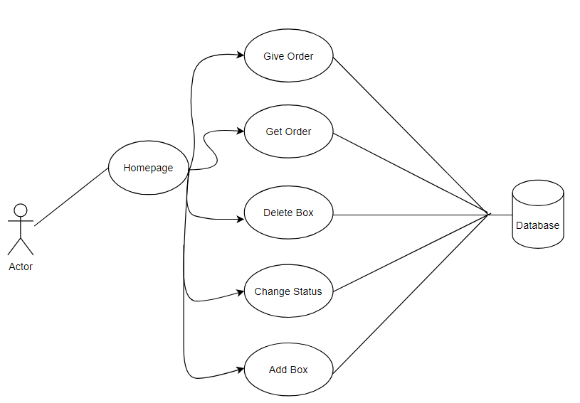
Use Case Diagram
Chaitanya

Slide 34
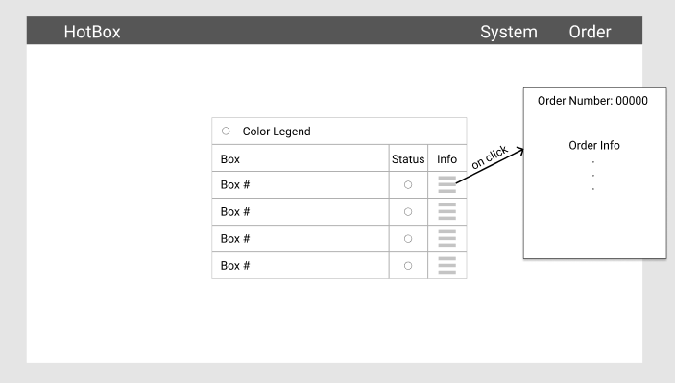
Frontend
Main page will display all boxes in system
Each box will display status (active or inactive)
Selecting box will bring up order details related to box
Ability to create an order
Ability to edit HotBox system
Send GET/POST requests of orders with API
Austin

Slide 35
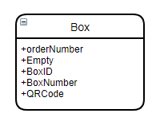
Backend
Schema for each box is stored in MongoDB.
Uses HTTP requests to create interactions between box, web app, and database.
Basic requests include:
AddBox
DeleteBox
GiveOrder
GetOrder
GetStatus
BoxStatus
QRCode implementation is done in the backend automatically.
Chaitanya

Slide 36
Difficulties
Scheduling and Meeting
Embedded Software Testing
Time limitations
Part Gathering
Austin

Slide 37
Budget So Far
Parts | Regular Cost | Shipping and Handling
Lock | $11.49 | $0.00 shipped by Amazon
Red Switch | $3.07 | $0.00 shipped by Allied Electronics
Relay | $7.99 | $0.00 shipped by Amazon
LCD Display | $8.99 | $0.00 shipped by Amazon
ESP32 | $10.99 | $0.00 shipped by Amazon
12V DC Adapter | $4.50 | $0.00 shipped by Amazon
MEGA 2560 | $15.99 | $0.00 shipped by Amazon
Heating Bed | $18.99 | $0.00 shipped by Amazon
Total Cost: |  | $82.01
Ahmed

Slide 38
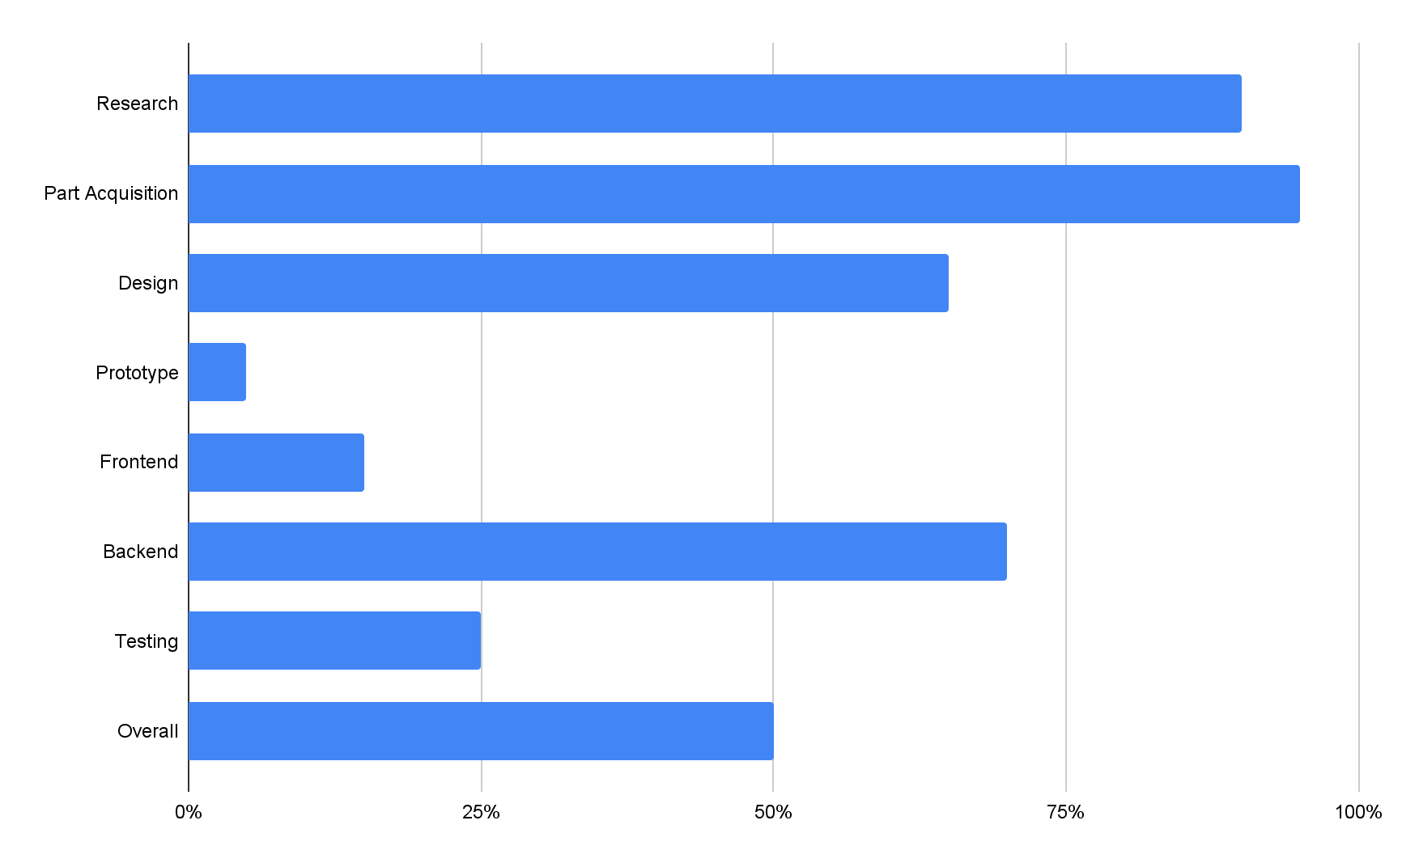
Percentage done chart
Austin

Slide 39
Questions?

